Slide 1


Slide 2


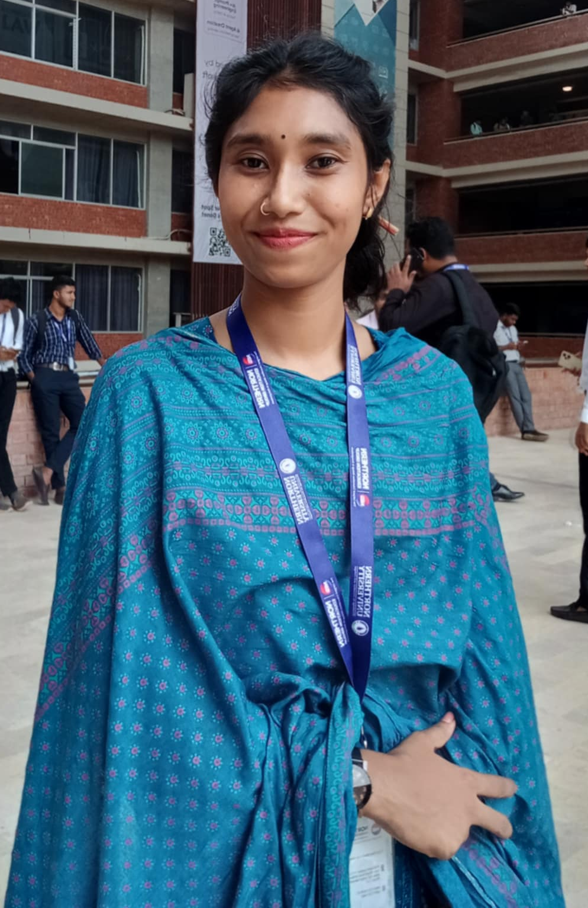

Yeamin Khan Dimon
BSC In Computer Science and Technology NORTHERN UNIVERSITY BANGLADESH
OUR TEAM

Slide 3

Ajifa Afrose
BSC In Computer Science and Technology NORTHERN UNIVERSITY BANGLADESH
OUR TEAM

Slide 4



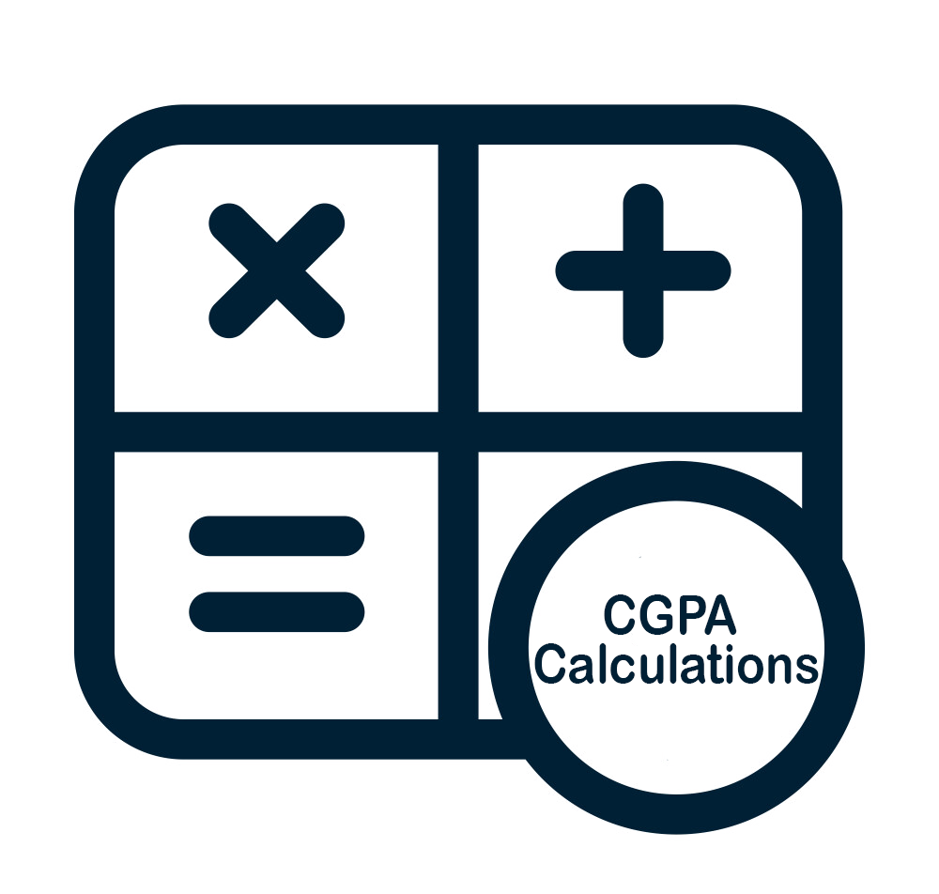
Student CGPA Management System in C
Depa Rani Joba
BSC In Computer Science and Technology NORTHERN UNIVERSITY BANGLADESH
Calculate CGPA
Reports generated
Searching Students Reports
OUR TEAM

Slide 5

Features Explanation
Number of Subject: Subject Name: Subject Code: Subject Credit:
Student Name: Student Roll: Grade Point:
Student CGPA Management System in C
Input
Input
Output
Subject Details:
Subject 1:
Name : math
Code : math 123
Credit : 3.00
Grade Point : 3.45
Grade Letter : B+
Add another student? (yes/no): Search student CGPA:
Output
Student CGPA Report
Name : Yeamin Khan Dimon
Roll : 42250102224
Total Credit : 3.00
CGPA : 3.45
Grade Letter : B+
Calculate CGPA
Reports generated
Searching Students Reports

Slide 6

Diagram and output
Enter number of subjects: 2
Subject 1:
Enter subject name: Software Development I (C Programming)
Enter subject code: CSE 1307
Enter credit for subject: 1.0
Subject 2:
Enter subject name: Object-Oriented Programming-I (C++)
Enter subject code: CSE 1307
Enter credit for subject: 3.0
Enter student name: Yeamin Khan Dimon
Enter student roll number: 42250102224
Enter grade point for Software Development I (C Programming)
: 3.45
Enter grade point for Object-Oriented Programming-I (C++)
: 3.50
----- Student CGPA Report -----
Name : Yeamin Khan Dimon
Roll : 42250102224
Total Credit : 4.00
CGPA : 3.50
Grade Letter : A-
Subject Details:
Subject 1:
Name : Software Development I (C Programming)
Code : CSE 1290
Credit : 1.00
Grade Point : 3.50
Grade Letter : A-
Subject 2:
Name : Object-Oriented Programming-I (C++)
Code : CSE 1307
Credit : 3.00
Grade Point : 3.50
Grade Letter : A-
Features Explanation
Number of Subject: Subject Name: Subject Code: Subject Credit:
Student Name: Student Roll: Grade Point:
Input
Input
Output
Subject Details:
Subject 1:
Name : math
Code : math 123
Credit : 3.00
Grade Point : 3.45
Grade Letter : B+
Add another student? (yes/no): Search student CGPA:
Output
Student CGPA Report
Name : Yeamin Khan Dimon
Roll : 42250102224
Total Credit : 3.00
CGPA : 3.45
Grade Letter : B+

Slide 7

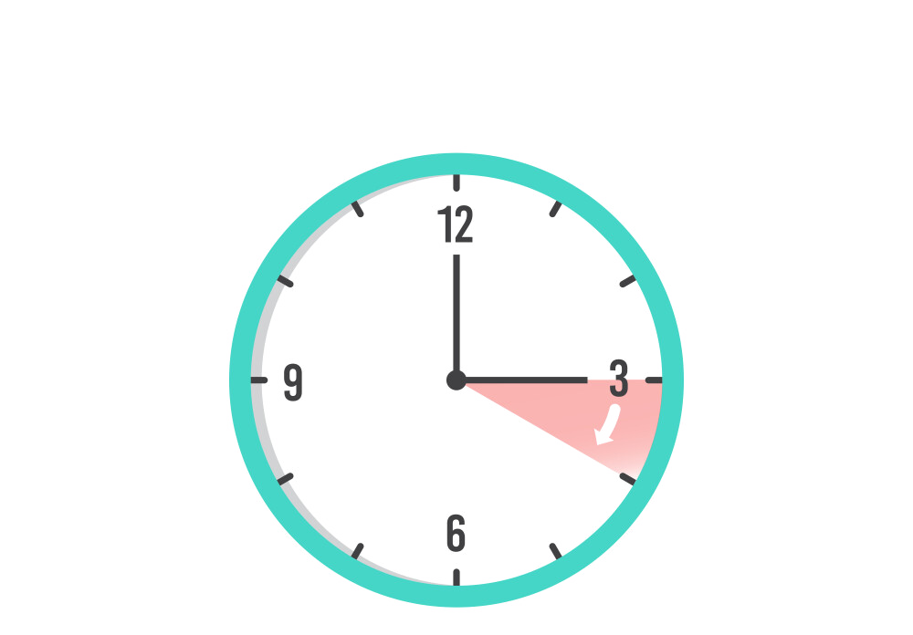


Advantages
Enter number of subjects: 2
Subject 1:
Enter subject name: Software Development I (C Programming)
Enter subject code: CSE 1307
Enter credit for subject: 1.0
Subject 2:
Enter subject name: Object-Oriented Programming-I (C++)
Enter subject code: CSE 1307
Enter credit for subject: 3.0
Enter student name: Yeamin Khan Dimon
Enter student roll number: 42250102224
Enter grade point for Software Development I (C Programming)
: 3.45
Enter grade point for Object-Oriented Programming-I (C++)
: 3.50
----- Student CGPA Report -----
Name : Yeamin Khan Dimon
Roll : 42250102224
Total Credit : 4.00
CGPA : 3.50
Grade Letter : A-
Subject Details:
Subject 1:
Name : Software Development I (C Programming)
Code : CSE 1290
Credit : 1.00
Grade Point : 3.50
Grade Letter : A-
Subject 2:
Name : Object-Oriented Programming-I (C++)
Code : CSE 1307
Credit : 3.00
Grade Point : 3.50
Grade Letter : A-
Student Data
Md, Yeamin Khan Dimon Depa Rani Joba Ajifa afrose
Diagram and output
Time Saving
Multiple Student Data
Search Student Roll

Slide 8

Limitations
Advantages
Only 1 Semester
The file is not searched directly
Student Data
Md, Yeamin Khan Dimon Depa Rani Joba Ajifa afrose
Conclusion
Automates Student CGPA Calculation
Easy, Fast, Reliable and Extendable
Time Saving
Multiple Student Data
Search Student Roll

Slide 9
Limitations
Only 1 Semester
The file is not searched directly
Conclusion
Automates Student CGPA Calculation
Easy, Fast, Reliable and Extendable

